Slide 1
Component Hierarchy
Landing / Sign-In Page
Booking Page
Booking Detail Pop-up
User Appointments Page
Nav Bar
Booking Details
Sign Up / Edit Profile Page
Nav Bar
User Booking Filter
Nav Bar
Booking Details
Booking Calendar
Service Provider Calendar Page
Service Provider Manage Discounts Page
User Appointments Page
Nav Bar
Nav Bar
Nav Bar
Booking Calendar
Booking Details
Discount Config Module

Slide 2
Viciniti
Username
Password
Don’t have an account? Sign Up

Slide 3
Viciniti
Create Account
Username
Password
Email
Address
Phone Number
Service Provider
Service User

Slide 4
Viciniti
Create Account
Username
Password
Email
Address
Phone Number
Service Provider
Service User
Add Services
Manicures, Pedicures

Slide 5
Viciniti
Profile Log Out
Home My Appointments
Search
Beauty
Cleaning
Pet Care
Chef
Car Care
Errands
Handyman
Hair
Nails Makeup
Skin Treatment
Tanning

Slide 6
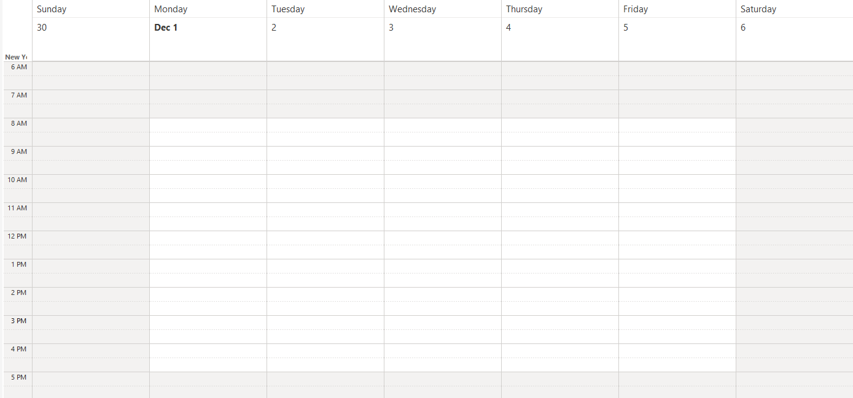
Viciniti
Profile Log Out
Home My Appointments
Search
Beauty
Cleaning
Pet Care
Chef
Car Care
Errands
Handyman
Hair
Nails Makeup
Skin Treatment
Tanning
Manicure $80
Manicure $90
Manicure $80
Manicure $80
Manicure $60
Manicure $60
Manicure $80
Manicure $60
Manicure $70
Manicure $70

Slide 7
Viciniti
Profile Log Out
Home My Appointments
Manicure $80
Manicure Appt $80
Manicure $80
Manicure $80
Manicure $60
Manicure $60
Manicure $80
Manicure Appt $80
Manicure $60
Manicure $70
Manicure $70

Slide 8
Viciniti
Profile Log Out
Home My Appointments
Se Up Availability
Manicure
Date: 12/1/2025
Time: 1:00pm – 2:00pm
Manicure $80
Select Service
Manicure $80
Manicure $80
Manicure $60
$70
Manicure $60
Manicure $80
Confirm
Cancel
Manicure $60
Manicure $70
Manicure $70

Slide 9
Viciniti
Profile Log Out
Home My Appointments
Search
Beauty
Cleaning
Pet Care
Chef
Car Care
Errands
Handyman
Hair
Nails Makeup
Skin Treatment
Tanning
Manicure
Date: 12/1/2025
Time: 1:00pm – 2:00pm
$70
Manicure $80
Manicure $80
Manicure $80
Manicure $60
Manicure $60
Confirm
Cancel
Manicure $80
Manicure $60
Manicure $70
Manicure $70

Slide 10
Viciniti
Profile Log Out
Home
My Appointments
Manicure
Date: 12/1/2025
Time: 1:00pm – 2:00pm
Edit
Cancel
Haircut
Date: 12/3/2025
Time: 1:00pm – 2:00pm
Edit
Cancel
House Cleaning
Date: 12/7/2025
Time: 1:00pm – 2:00pm
Edit
Cancel

Slide 11
Viciniti
Profile Log Out
Home My Appointments
Discount Configuration
+1 Appt
+2 Appt
+3 Appt
+4 Appt
+5 Appt
Tier 1
15%
20%
25%
30%
35%
0
200yds
Tier 2
12%
15%
13%
21%
24%
200yds
600yds
Tier 3
10%
11%
12%
13%
14%
600yds
1 mile
Tier 4
5%
6%
7%
8%
9%
1 mile
3 miles

